Slide 1
Low-power Design at RTL level
Mohammad Sharifkhani

Slide 2
Motivation
All efficient low-power techniques that has been introduced depends on:
Technology enhancement
Specific Standard Cell Library
Analog Design Support
This means
Higher cost
Longer design time
Sometimes less reliable product

Slide 3
Motivation
At RTL we may reduce the number of transition through simple and smart ideas
Mostly affects dynamic power ➔ effective capacitance
Methods : Too many to count
A number of them are standardized in EDA tools (Synopsys DC)

Slide 4
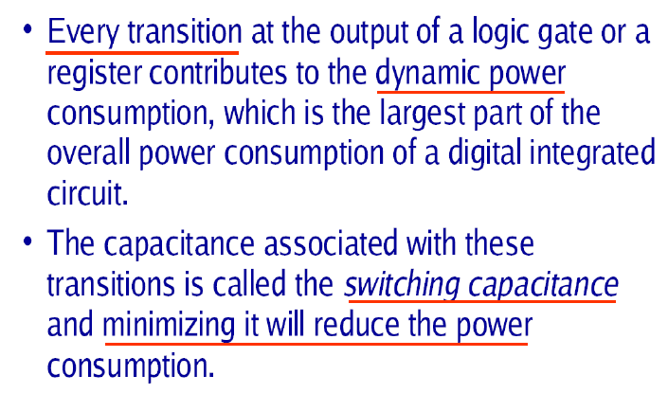
Motivation

Slide 5
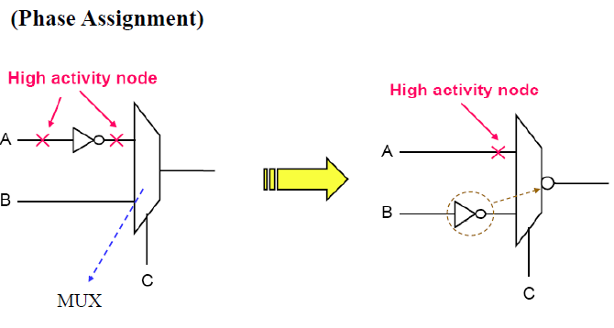
Motivation

Slide 6
Introduction
Signal coding
Clock gating
Double edge clocking
Glitch reduction
Operand Isolation
Pre-computation
concurrency Insertion
Parallelism and Pipelining
Algorithm level

Slide 7
Signal Coding
The amount of power consumption is tightly related to the number of transition
A combination of bits create a concept for a digital signal (e.g., a number, an address, a command, state of an FSM, …)
Consider it when it runs over a long bus
We may take the advantage of the properties of this concept to save the number of transition that we need to communicate it
What does WinZip do?

Slide 8
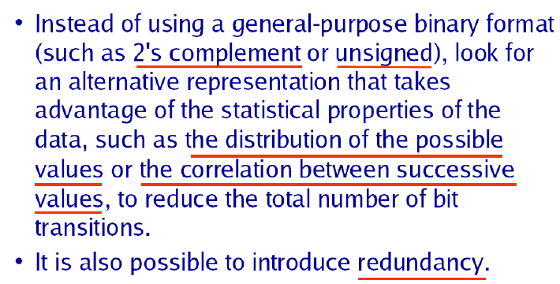
Signal Coding
Some codes are never used

Slide 9
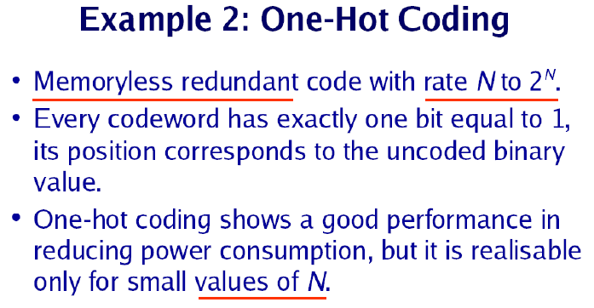
Signal Coding

Slide 10
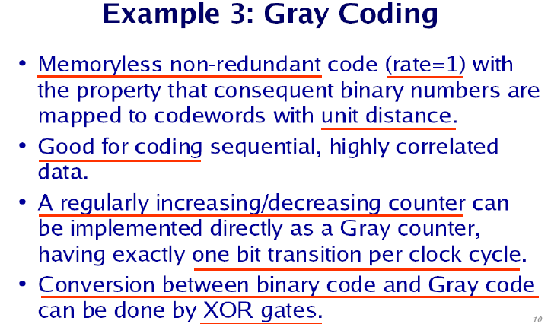
Signal Coding

Slide 11
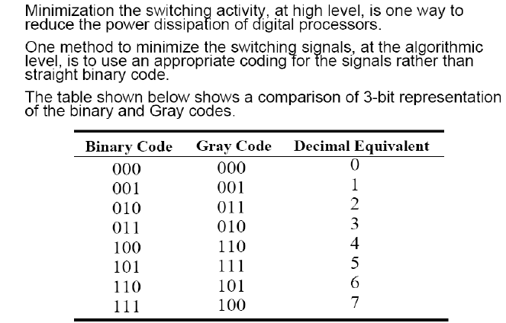
Signal Coding

Slide 12
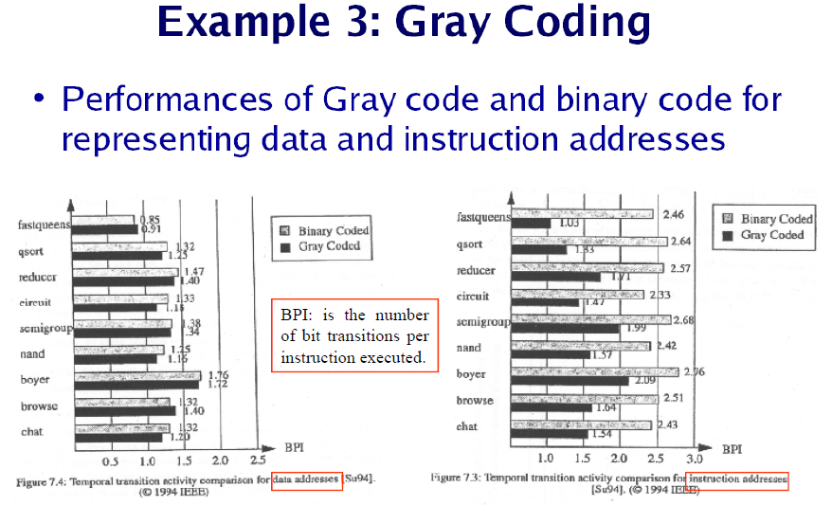
Signal Coding

Slide 13
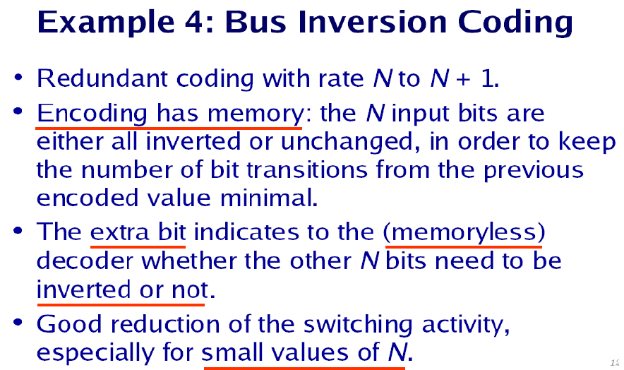
Signal Coding

Slide 14
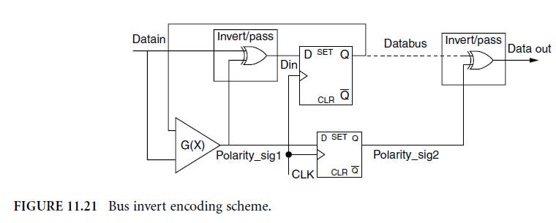
Signal Coding
Hamming Distance between two consecutive codes: complexity

Slide 15
Signal Coding
An improvement consists of making the guess that if the most significant bit (MSB) is “1,” the inverted code should be transmitted. The MSB = “1” can be used as the polarity information. Thistechnique is efficient when the vector to transmit is a 2’s complement arithmetic data bus, with MSB being the sign bit.

Slide 16
Signal Coding
Very often, the value transmitted on a bus (an address bus, for instance) is simply the previous value with an increment. Therefore, the lines can remain the same (i.e., no power consumption) as long as the codes are consecutive, which is mentioned to the receiver by an additional control signal.
We may also extend this approach to other known high probably sequences (0000 to 1010 in a given design)

Slide 17
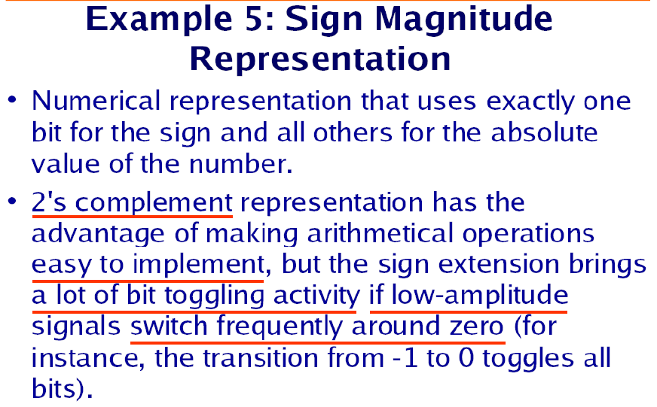
Signal Coding

Slide 18
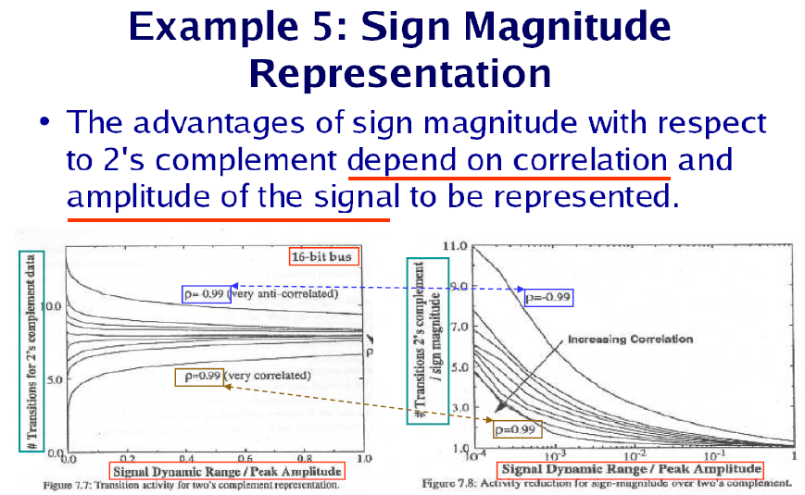
Signal Coding

Slide 19
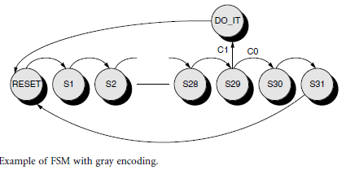
Signal Coding
FSM state encoding scheme
Most of the times the code we use to represent a state is arbitrary ➔ let’s choose it in a low-power manner ➔ minimal transition between the states
We should minimize the hamming distance of the transition with high probability.

Slide 20
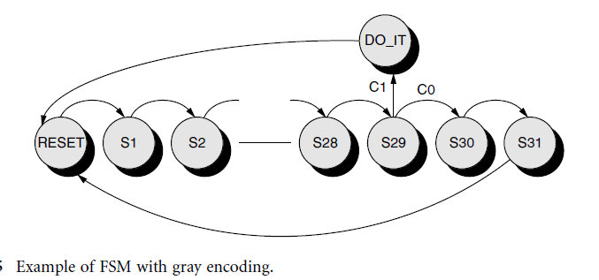
Signal Coding
State encoding:
From RESET to S29 are chained sequentially with 100%
probability of transition ➔ a gray encoding is the best choice.
If we assume that condition C0 has a much lower probability than C1, the gray encoding should be not be incremented from S29 to S30 and S31.

Slide 21
Signal Coding
What we gain in the next-state logic might be lost in the output logic activity ➔ trade-off
The power reduction on the output logic
Common choice: “one hot” encoding to optimize speed, area, and power for the output logic
Only valid for a small FSM (i.e., less than 8 to 10 states) because of the large state register
A good practice is to group states that generate the same outputs and assign them codes with minimum hamming distance.

Slide 22
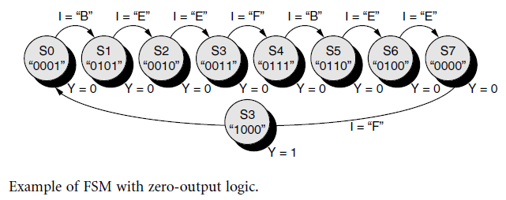
Signal Coding
What does it do? (I: input, Y: output)
The encoding proposed achieves both a minimum “next-state logic” activity due to the “gray-like” encoding
No power consumption at all in the output logic because the orthogonal encoding defines the most significant bit of the state register as the flag Y itself.

Slide 23
Introduction
Signal coding
Clock gating
Double edge clocking
Glitch reduction
Operand Isolation
Pre-computation
concurrency Insertion
Parallelism and Pipelining
Algorithm level

Slide 24
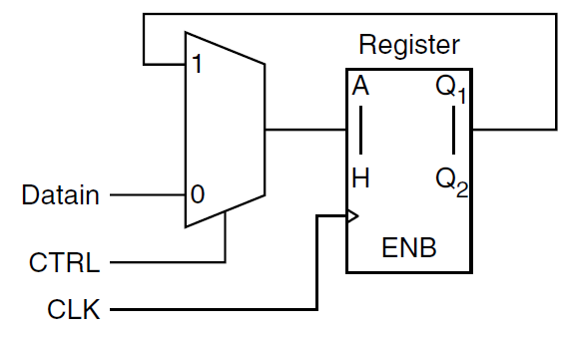
Clock gating
Clock signal:
Highest transition probability
Long lines and interconnections
Consumes a significant fraction of power (sometimes more than 40% if not guarded)
Idea: gate the clock if is not needed
Popular and standardized in EDA tools

Slide 30
Clock gating
FF
A(x)
X
CLK
We can gate the clock of FFs if the output value of A is not needed
Saves the power in:
Clock tree
Fan-out of FF (A)
FF themselves
Can be implemented in:
Module level
Register level
Cell level

Slide 31
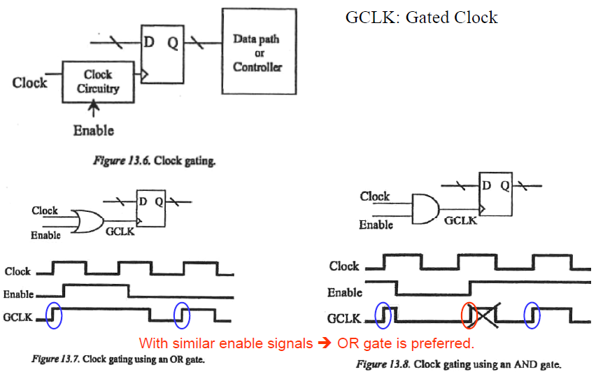
Clock gating

Slide 32
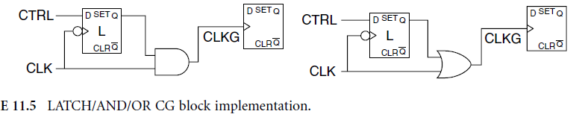
Clock gating
To eliminate the glitches on CLKG a latched based approach is favorable
An alternative and better solution : a latch L transparent (when the clock is low) and an AND gate. With this configuration, the spurious transitions generated by function Fcg (clock gating function) are filtered.

Slide 33
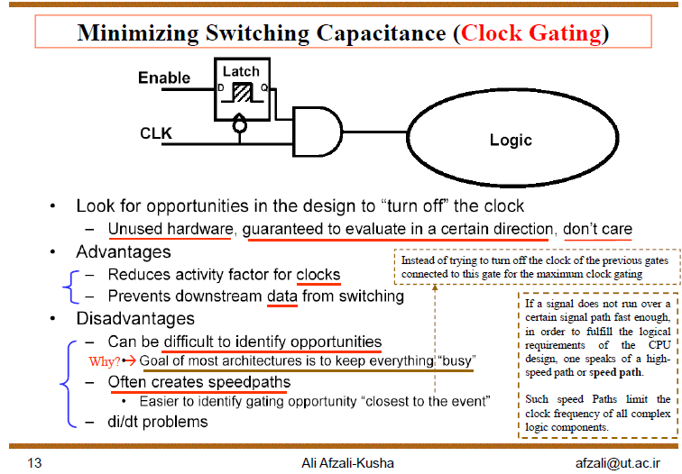
Clock gating

Slide 34
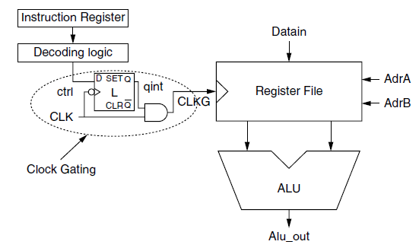
Clock gating
Example:
The clock-gating file and the register file : physically close to reduce the impact on the skew and to prevent unwanted optimizations during the synthesis.
They can be modeled by two separate Processes (VHDL) in the same hierarchical block, synthesized,
Then inserted into the parent hierarchy with a “don’t touch” attribute.

Slide 35
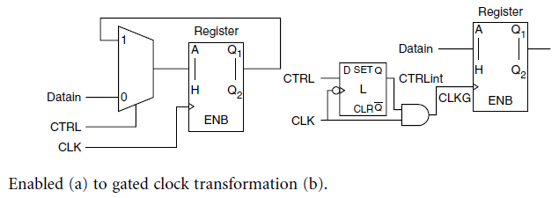
Clock gating
Reduced area and power ☺
Testability and clock skew ☹

Slide 36
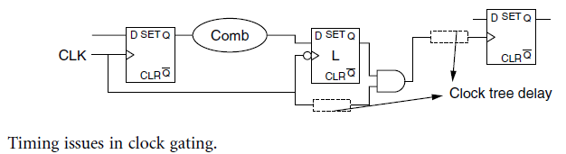
Clock gating
Timing issues:
setup time or hold time violations.
In most power design flows, the clock gating is inserted before the clock tree synthesis. ➔
the designer has to estimate the delay impact of the clock tree from the clock gate to the gated register as depicted.
by setting some variables allow the designer to specify these critical times before synthesis.

Slide 37
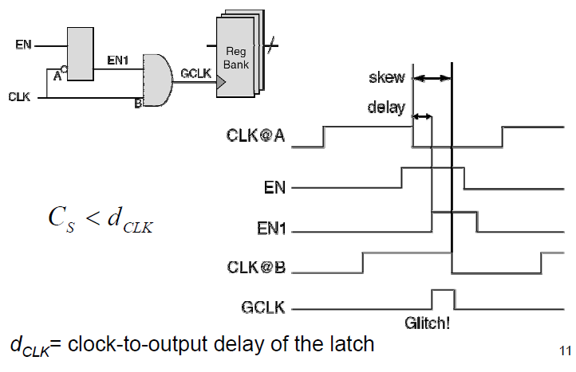
Clock gating
Positive skew on B (B later than A) can create glitch if not controlled!
Clock skew must be less than
Clock to output delay of the latch
The skew between A and B creates a Glitch

Slide 38
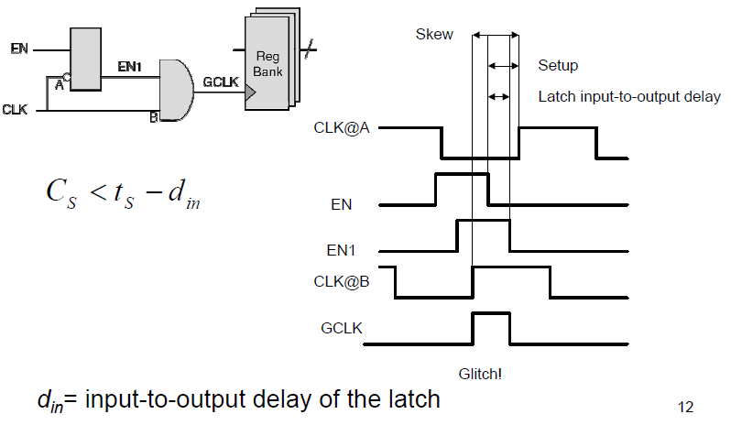
Clock gating
Negative skew on B (B earlier than A) can create glitch if not controlled!
If B comes earlier than the correct EN1 appears at AND input, it creates a glitch
The skew between A and B creates a Glitch

Slide 39
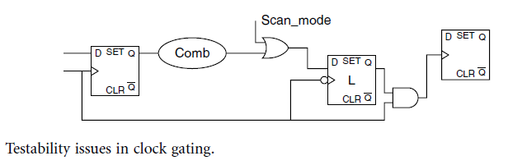
Clock gating
Testability issues
Clock gating introduces multiple clock domains in the design ➔ no clock during the test phase
One way to improve the testability of the design is to insert a control point, which is an OR gate controlled by an additional signal scan_mode.
Its task is to eliminate the function of the clock gate during the test phase and thus restores the controllability of the clock signal.

Slide 40
Clock gating
How to find a group of FF for gating:
Hold condition detection: Flip-flops that share the same hold condition are detected and grouped to share the clock-gating circuitry. This method is not applicable to enabled flip-flops.
Redundant-clocking detection: The method is simulation-based. Flip-flops are grouped with regard to the simulation traces to share the clock-gating circuitry. It is obvious that this method cannot be automated.

Slide 41
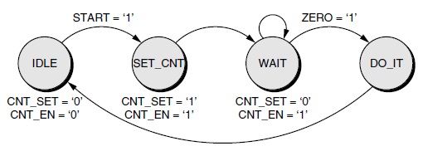
Clock gating
In FSM clock gating can be used efficiently:
It is not useful to have switching activity in the next-state logic or to distribute the clock if the state register will sample the same vector

Slide 42
Clock gating
Example: A FSM that interacts with a timer-counter to implement a very long delay of thousands of clock cycles before executing a complex but very short operation (in the DO_IT state).
We can use the clock-gating techniques to freeze the clock and the input signals as long as the ZERO flag from the time-out counter is not raised.
Efficient because:
FSM spends most of the time in the WAIT state.
More efficient if the FSM is used to control a very large datapath which outputs will not be used in the WAIT state. ➔ We can gate the clock or mask the inputs of this datapath and, therefore, avoid dynamic power consumption during all the countdown phases.
It is the RTL designer’s task to try to extract these small subparts of the FSM, isolate them, and then freeze the rest of the logic that is large and that most of the time does not achieve any useful computation.

Slide 43
Clock gating
FSM partitioning can be applied to adopt clock gating:
Subroutines in software ➔ part of an FSM may only be called in certain conditions ➔ we can separate it and gate its clock
Other words: Decompose a large FSM into several simpler FSMs with smaller state registers and combinatorial logic blocks. Only the active FSM receives clock and switching inputs. The others are static and do not consume any dynamic power.

Slide 44
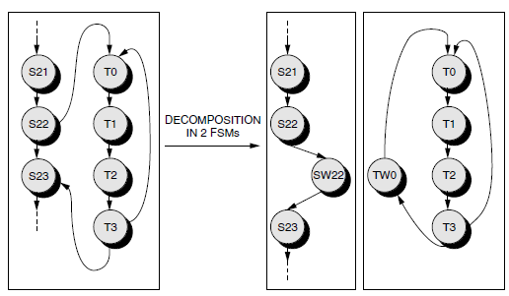
Clock gating
We can easily partition the big FSM into two parts and isolate the subroutine loop. We add a wait state, SW22 and TW0, between the entry and exit points of the subroutine in both FSMs.
Mutually exclusive FSMs (when one is running the other is off)

Slide 45
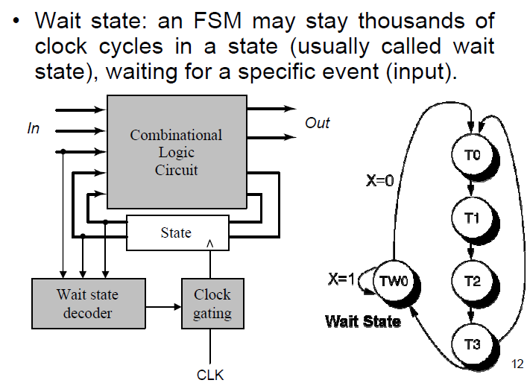
Clock gating

Slide 46
Introduction
Signal coding
Clock gating
Double edge clocking
Glitch reduction
Operand Isolation
Pre-computation
concurrency Insertion
Parallelism and Pipelining
Algorithm level

Slide 47
Double edge clocking
Major constraint for a digital system is throughput (bps: read it op/sec)
For a given architecture:
The number of ‘clock cycles in a second’ is a linear function of throughput:
One operation/clock cycle
For a given throughput (op/sec) the amount of energy/sec is fixed
Every ‘clock cycle’ consumes constant power on clock tree (cycle includes positive and negative)
Idea: we can half the clock tree power if we double the number of operation in a given ‘clock cycle’ ➔ double edge clocking

Slide 48
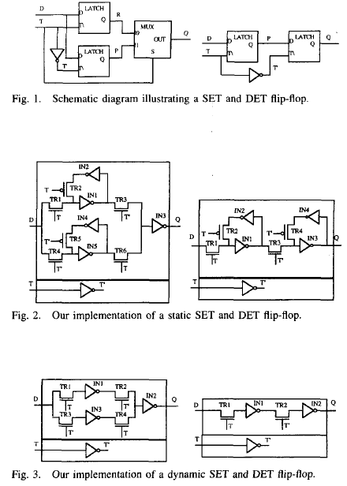
Double edge clocking
Double edge triggered FF
Static
Dynamic
Zero threshold voltage for MOS is assumed

Slide 49
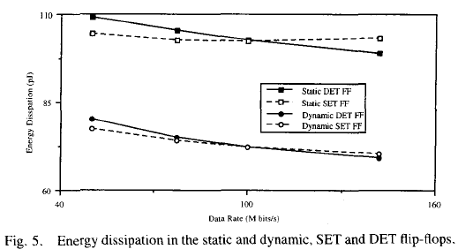
Double edge clocking
The ratio of the SET to DET FF energy consumption is:
(2n+3)/(2n+2).
Circuit simulation for a random vector:

Slide 50
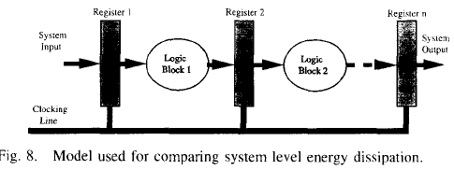
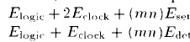
Double edge clocking
The energy consumption for SET and DET registers are
Higher pipelining order, better
Higher clock rate, better

Slide 51
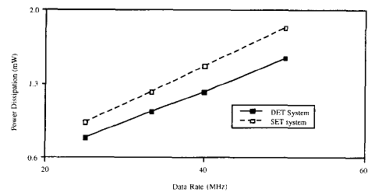
Double edge clocking
Ripple carry adder followed by a set of registers
For a given throughput the DET offers less power consumption

Slide 52
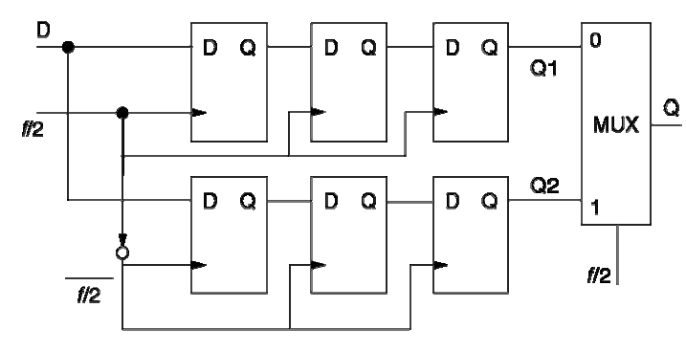
Double edge clocking
What is this?
How it saves power compared to the regular implementation?
Notes:
A parallel shift register

Slide 53
Introduction
Signal coding
Clock gating
Double edge clocking
Glitch reduction
Operand Isolation
Pre-computation
concurrency Insertion
Parallelism and Pipelining
Algorithm level

Slide 54
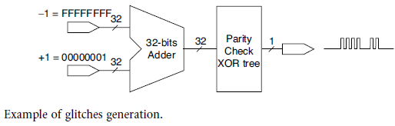
Glitch reduction
Glitch: The output of a combinational logic settles to the right value after a number of transitions between 1 and 0
Example: Parity of the output of a ripple carry adder when it adds ‘111111’ with ‘000001’.
Because of the parasitic capacitive coupling, glitches also affect the signal integrity and the timing closure
Glitch propagates!

Slide 55
Glitch reduction
Idea1: Use FF before you let a glitch propagate
Latency, control logic, more FF, clock tree, etc.
Latency may be a show stopper when specific requirements are demanded
Idea2: Use multi-phase clocking system:
Two phase master slave latch
Extra clock generation and routing overhead

Slide 56
Glitch reduction
Idea3: balance the delay in parallel combinatorial paths
Problematic when there is device variation in scaled CMOS
Idea4: use sum of product instead of generating the output based on casecade of multiple blocks : set_flatten true in the synthesis
Power and area
Example: for the parity in the above example, we may extract the parity directly from the input instead of an adder and XOR tree

Slide 57
Glitch reduction
Make use of naturally glitch resilient logic styles:
Domino style for example
Requires a dedicated library of cells and an additional clock signal. To map the RTL code, we can again use direct instances or synthesis scripts to control the inferences (e.g., set_dont_use and set_use_only).

Slide 58
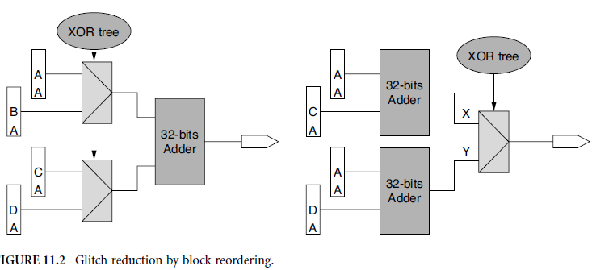
Glitch reduction
Glitch
mux
mux
Block reordering
Area is compromised, sometimes even power
Investigation is needed

Slide 59
Introduction
Signal coding
Clock gating
Double edge clocking
Glitch reduction
Operand Isolation
Pre-computation
concurrency Insertion
Parallelism and Pipelining
Algorithm level

Slide 60
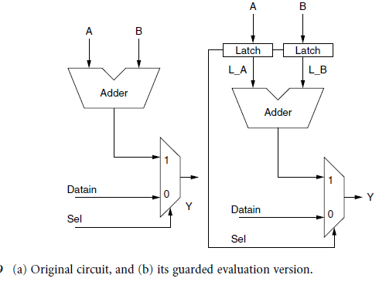
Operand Isolation
Block the operands to get through the (arithmetic) datapath if not needed

Slide 61
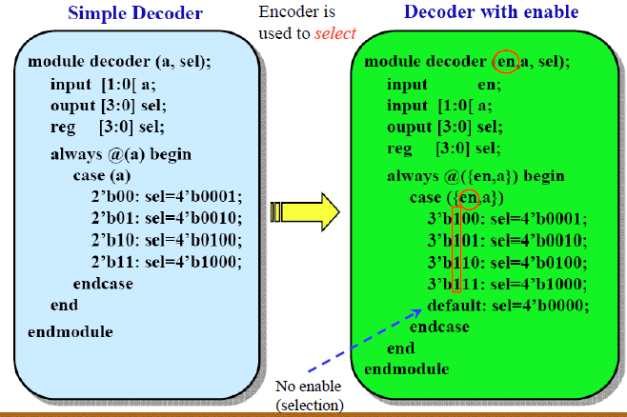
Operand Isolation

Slide 62
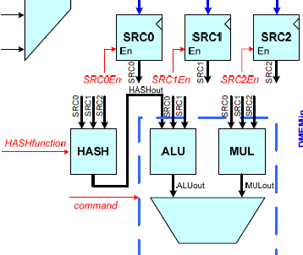
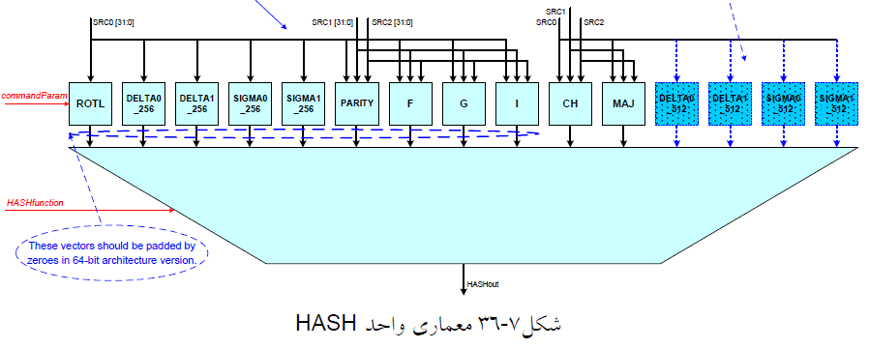
Operand Isolation
Example our multi-standard crypto-processor:

Slide 63
Operand Isolation
Control signal gating
Helps to reduce the switching on the buses
A Power Management Unit (PMU) is employed to decide which bus is truly needed to take a value
The rest of the busses remain inactive

Slide 64
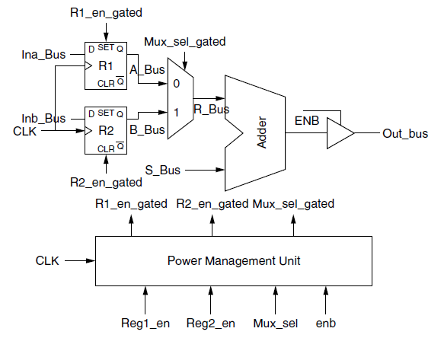
Operand Isolation
When enb is not active, mux_sel, reg1_en, and reg2_en can be gated, leading to a 100% switching activity reduction in R_Bus, A_bus, and B_Bus.
When mux-sel is active, either reg1_en and reg2_en can be gated depending on the value of mux-sel.

Slide 65
Introduction
Signal coding
Clock gating
Double edge clocking
Glitch reduction
Operand Isolation
Pre-computation
concurrency Insertion
Parallelism and Pipelining
Algorithm level

Slide 66
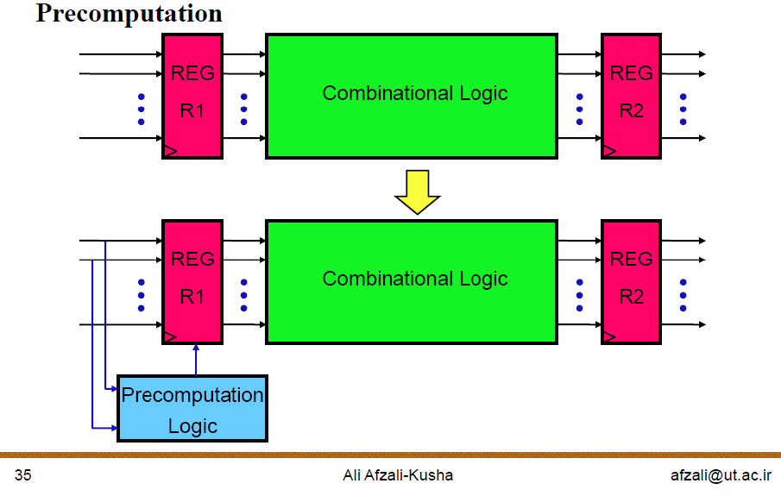
Precomputation

Slide 67
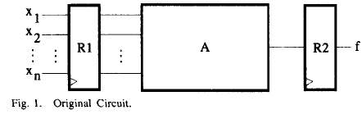
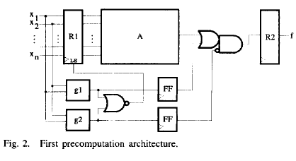
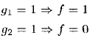
Precomputation
g1 and g2 are predictor functions which are
Mutually exclusive
Simpler than f
Affects the speed a bit (applied to non critical path)
Maximum probability of g1 or g2 becomes active is desired
Choice of g1, g2

Slide 68
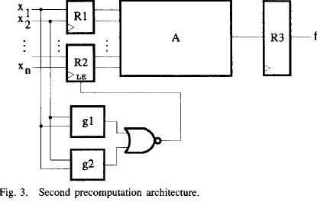
Precomputation
Partitioning the inputs to block A
Some of the inputs can be masked
The rest will do f
A power reduction is achieved because only a subset of the inputs to block A change implying reduced switching activity.
Less delay is imposed

Slide 69
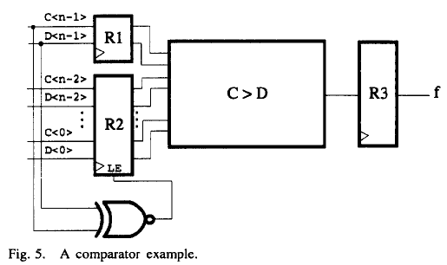
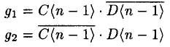
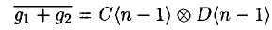
Precomputation
Clearly, when g1 = 1, C is greater than D, and when g2 =1 ,C is less than D. We have to implement

Slide 70
Introduction
Signal coding
Clock gating
Double edge clocking
Glitch reduction
Operand Isolation
Pre-computation
concurrency Insertion
Parallelism and Pipelining
Algorithm level

Slide 71
Algorithm level
Sometimes a job can be done in different way
Different algorithms
Different architectures
Design with power in mind
Lease switching activity in mind
Sometimes priory knowledge about the nature of the signals would be of help
DSP applications

Slide 72
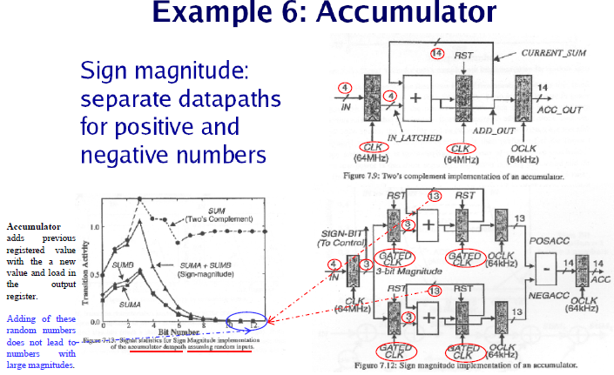
Algorithm level
Adds only positive values
Signal activity at different bits
Adds only negative values

Slide 73
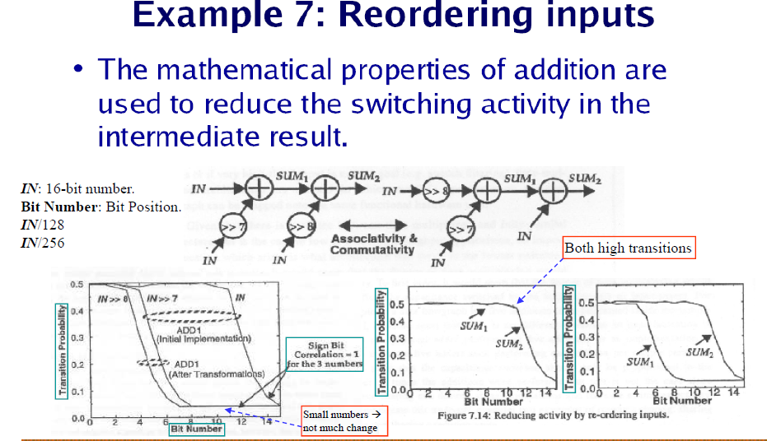
Algorithm level

Slide 74
Introduction
Signal coding
Clock gating
Double edge clocking
Glitch reduction
Operand Isolation
Pre-computation
concurrency Insertion
Parallelism and Pipelining
Algorithm level

Slide 75
concurrency Insertion
High enough speed (throughput) can be traded off with power
Lower supply voltage
Particularly useful in off critical path (where the speed is not important)
All hierarchical high throughput architectures can be treated as a low-power approach!
Concurrency insertion
Parallelism
Pipelining

Slide 76

concurrency insertion

Slide 77

Concurrency insertion

Slide 78

Concurrency insertion

Slide 79
Introduction
Signal coding
Clock gating
Double edge clocking
Glitch reduction
Operand Isolation
Pre-computation
concurrency Insertion
Parallelism and Pipelining
Algorithm level

Slide 80
Parallelism and Pipelining
Exploit parallel processing to achieve higher throughput and trade it off with lower supply voltage

Slide 81

Parallelism and Pipelining

Slide 82

Parallelism and Pipelining

Slide 83

Parallelism and Pipelining

Slide 84

Parallelism and Pipelining

Slide 85

Parallelism and Pipelining

Slide 86

Parallelism and Pipelining

Slide 87

Parallelism and Pipelining

Slide 88

Parallelism and Pipelining

Slide 89

Parallelism and Pipelining
A longer cycle time is needed for each
processor because of the lower voltage.

Slide 90

Parallelism and Pipelining

Slide 91

Parallelism and Pipelining

Slide 92

Parallelism and Pipelining

Slide 93

Parallelism and Pipelining

Slide 94

Parallelism and Pipelining

Slide 95

Parallelism and Pipelining

Slide 96

Parallelism and Pipelining

Slide 97

Parallelism and Pipelining

Slide 98

Parallelism and Pipelining

Slide 99
Conclusion

